Slide 1
INDEXES IN MONGODB
BY
AKHIL M ANIL

Slide 2
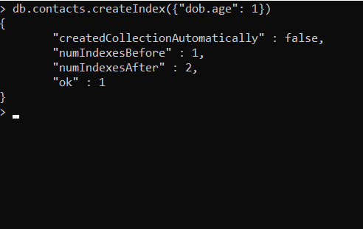
Create Index

Slide 3
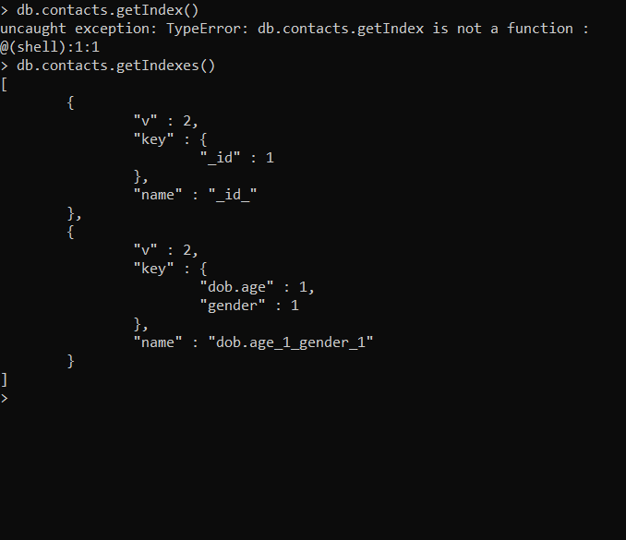
Get Index

Slide 4

Drop Index

Slide 5
Single Index

Slide 6
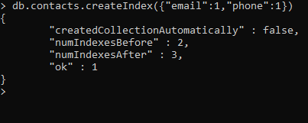
Compound Index

Slide 7
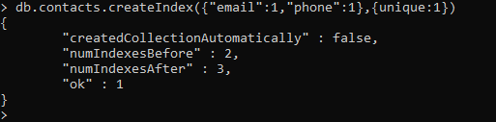
Unique Index

